Slide 1
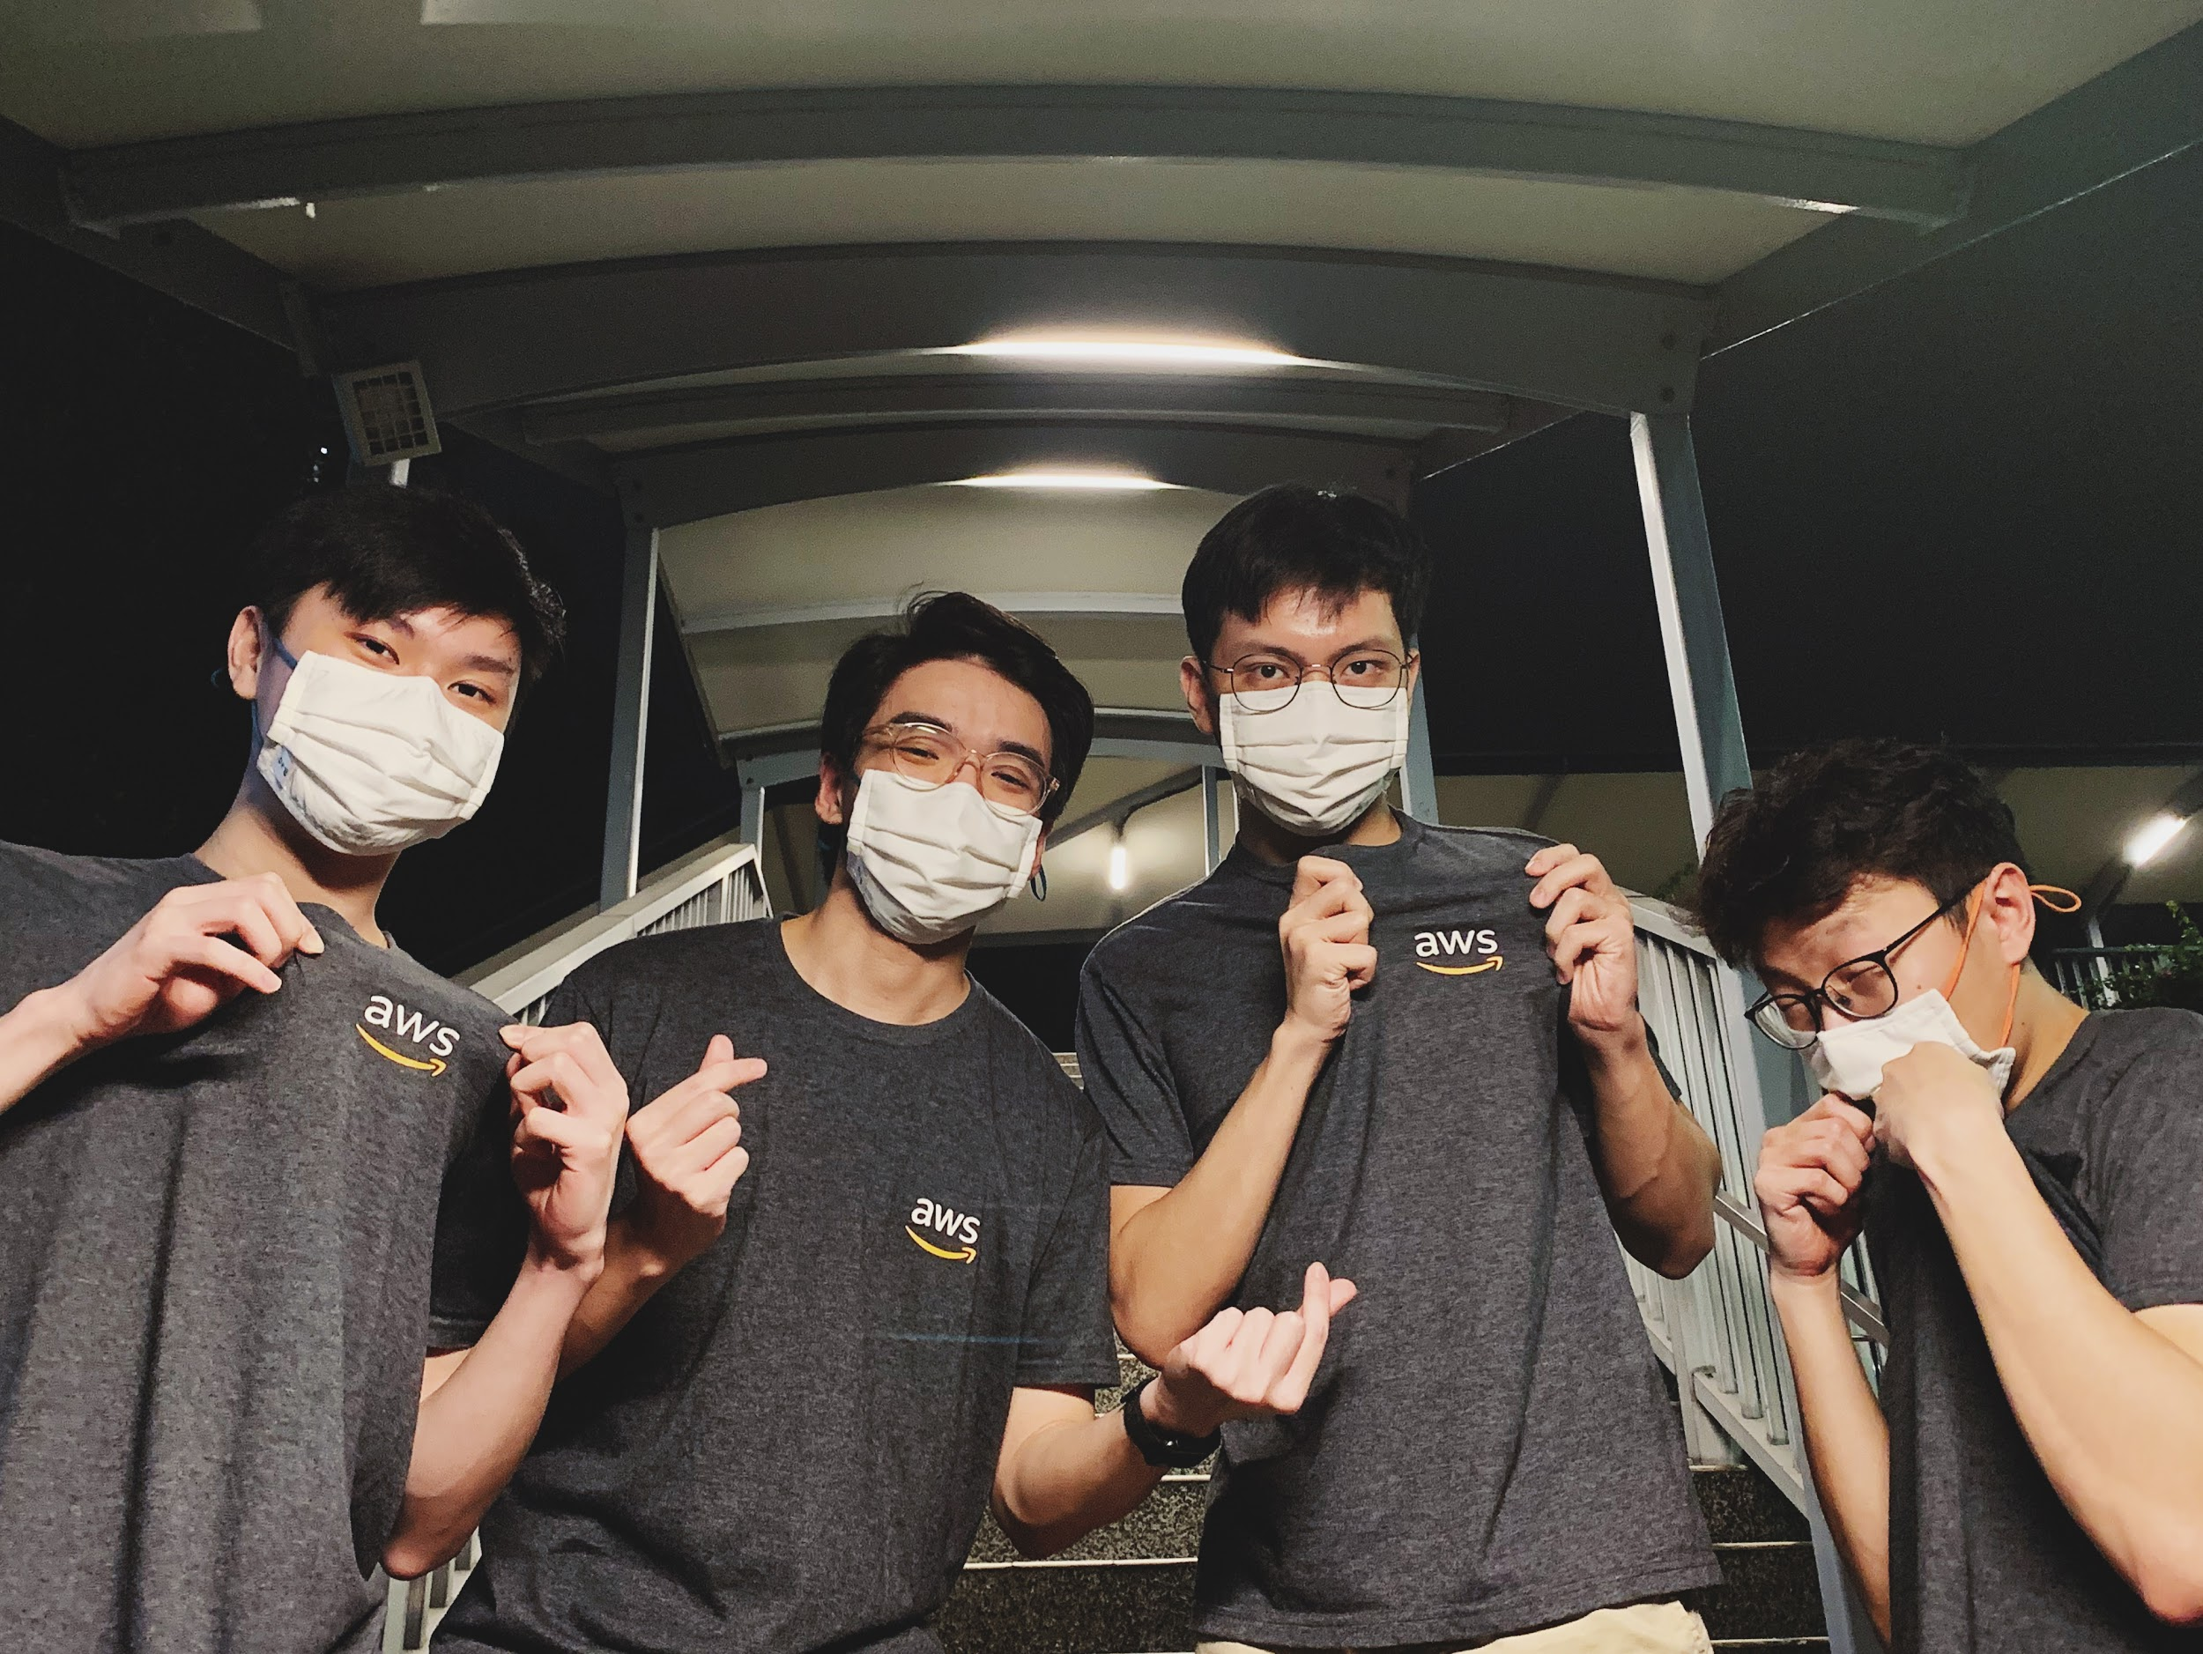
Live Smart Singapore Hackathon (ACRA)
Team ree-Cloud

Slide 2




Our Solution
A serverless web application with a dashboard for visibility into the cases and their statuses.
Ability to retrieve information from scanned documents using Amazon Textract
Automated review using Amazon SageMaker
Downloadable CSV file

Slide 3




Benefits of Solution
Less Human Errors
Automated Review
Scalable
Serverless Solution
Fault Tolerant
Pay-as-you-go
No more “Oops”
Do more in a shorter period of time
Quickly adapt to meet demand
No infrastructure to patch or maintain
No downtime, highly-available
Only pay for usage

Slide 4


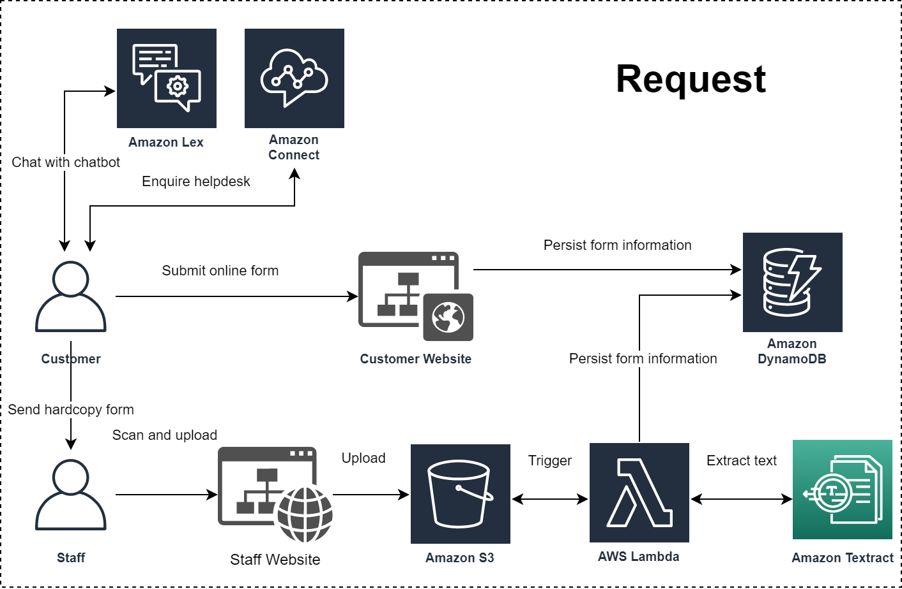
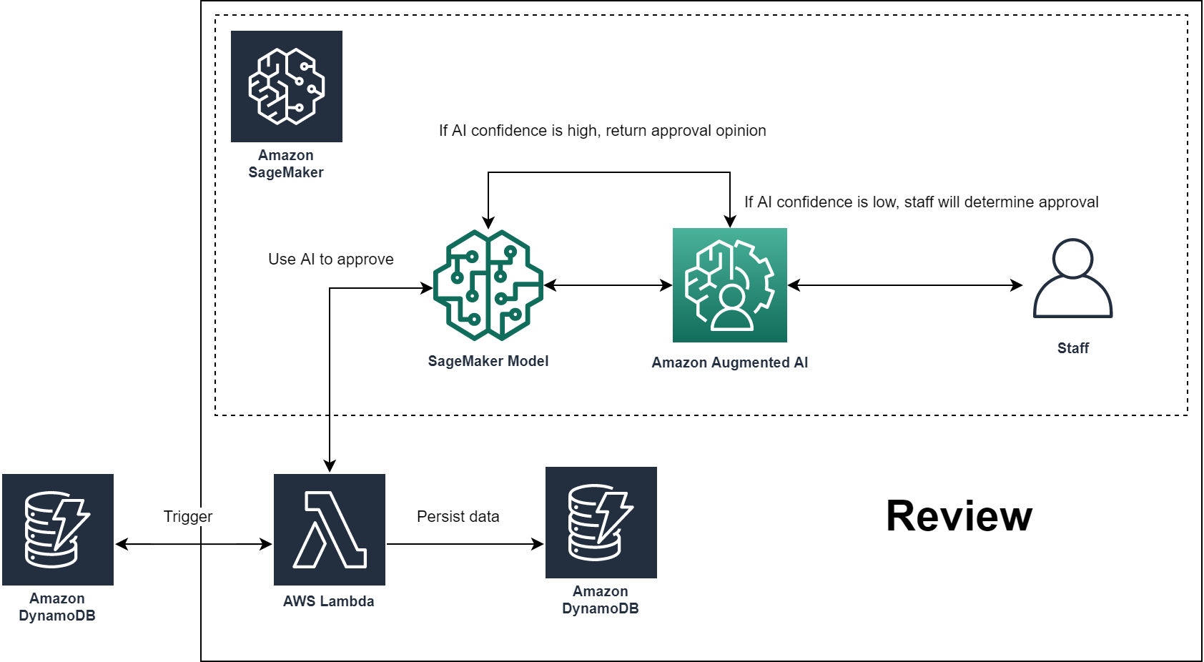
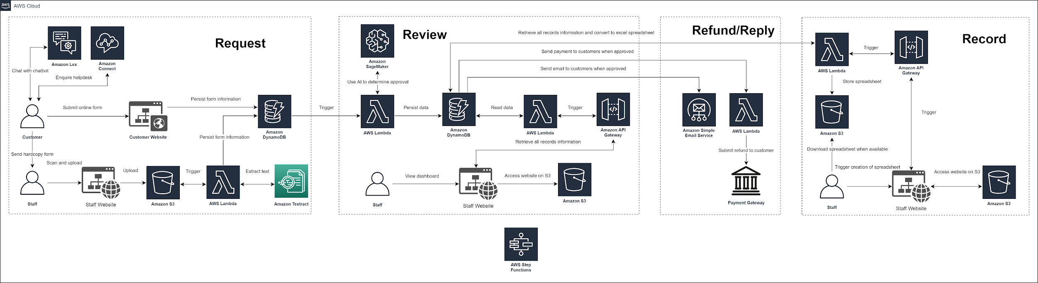




Architecture
Request
Review
Demo

Slide 5


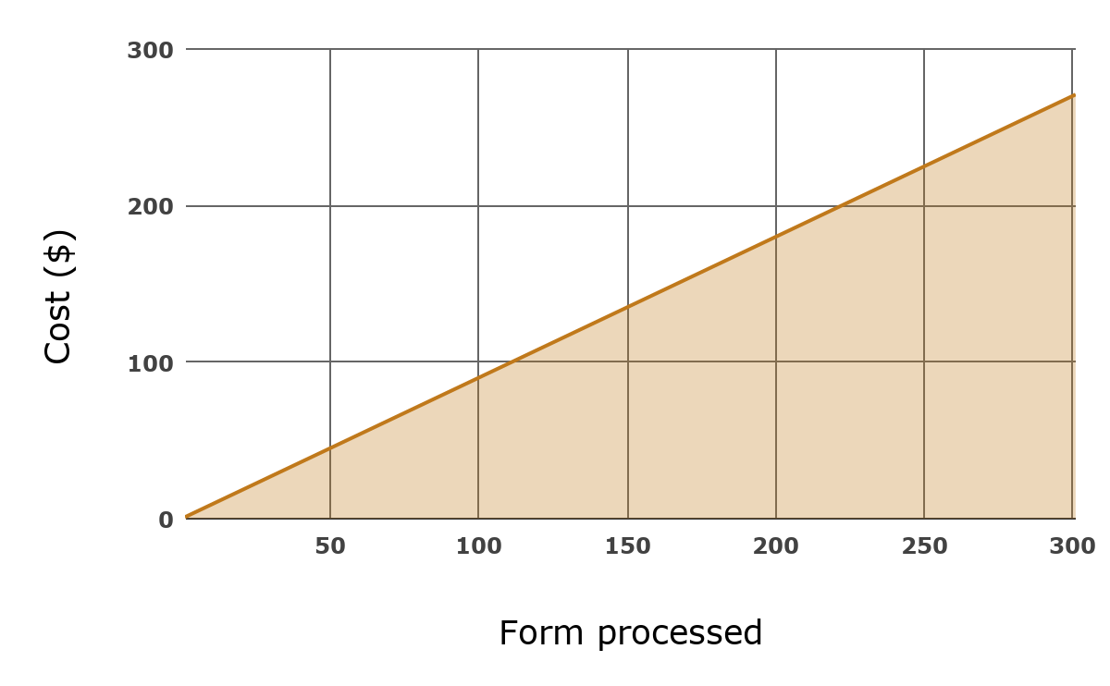
Cost Analysis
> $1.00
Per Form Processed
Pay less per form when scaling
Only pay for usage

